Slide 1

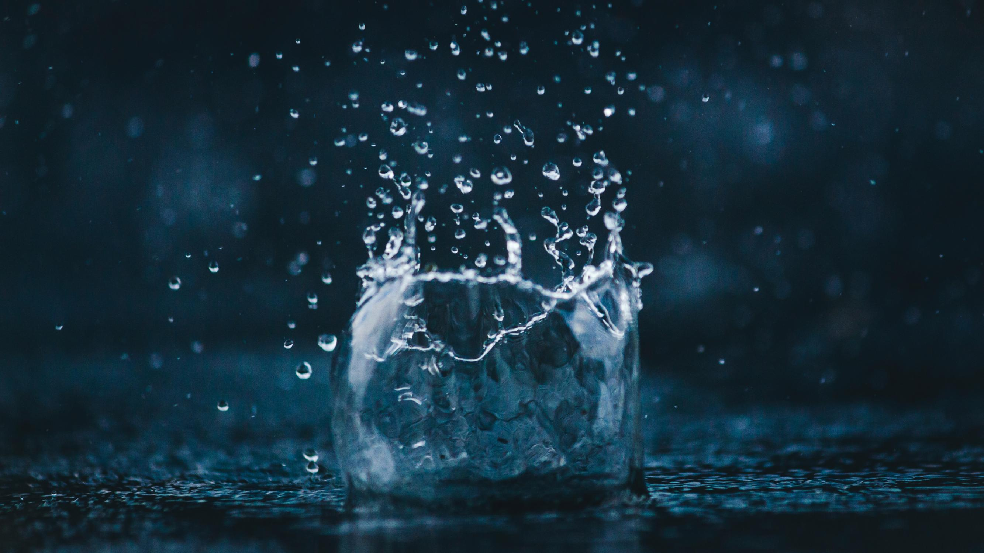
WATER QUALITY ANALYSIS
Presented by,
M. Prathab
U. Ajai
A. Salman

Slide 2
OBJECTIVES
1)DATA COLLECTION
2)DATA IMPORTING
3)DATA ANALYZING
4)DATA PREPROCESSING
5)DATA VISUALIZATION

Slide 3
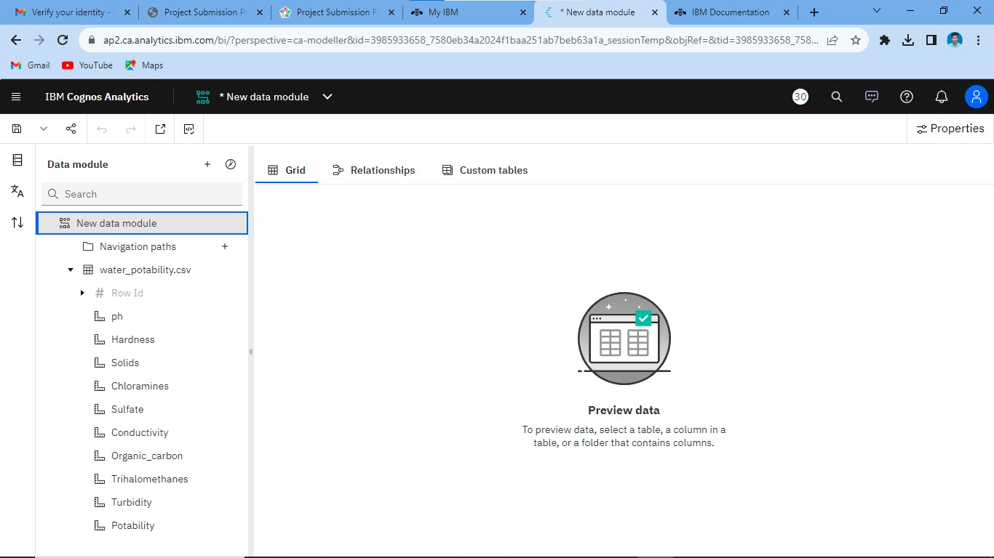
Step-1:Downloading and uploading the dataset
THE FOLLOWING DATASET IS DOWNLOADED AND IT IS SAVED IN FILE MANAGER AND IT IS UPLOADED

Slide 4
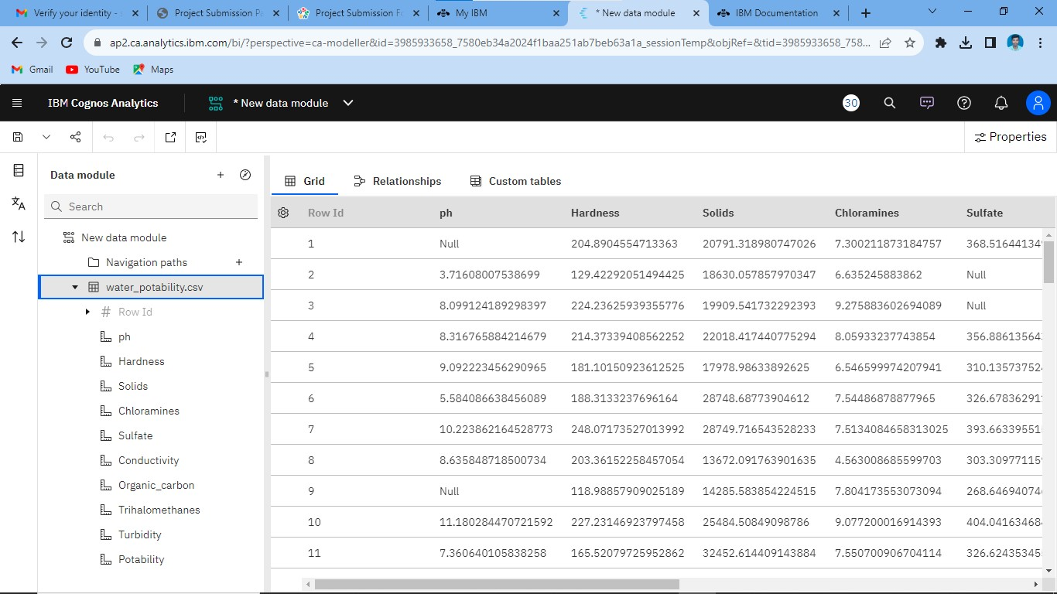
Step-2:Data collection and analysis
IN THIS STAGE ,DATA IS COLLECTED AND ANALYSED USING IBM COGNOS ANALYTICS SOFTWARE

Slide 5
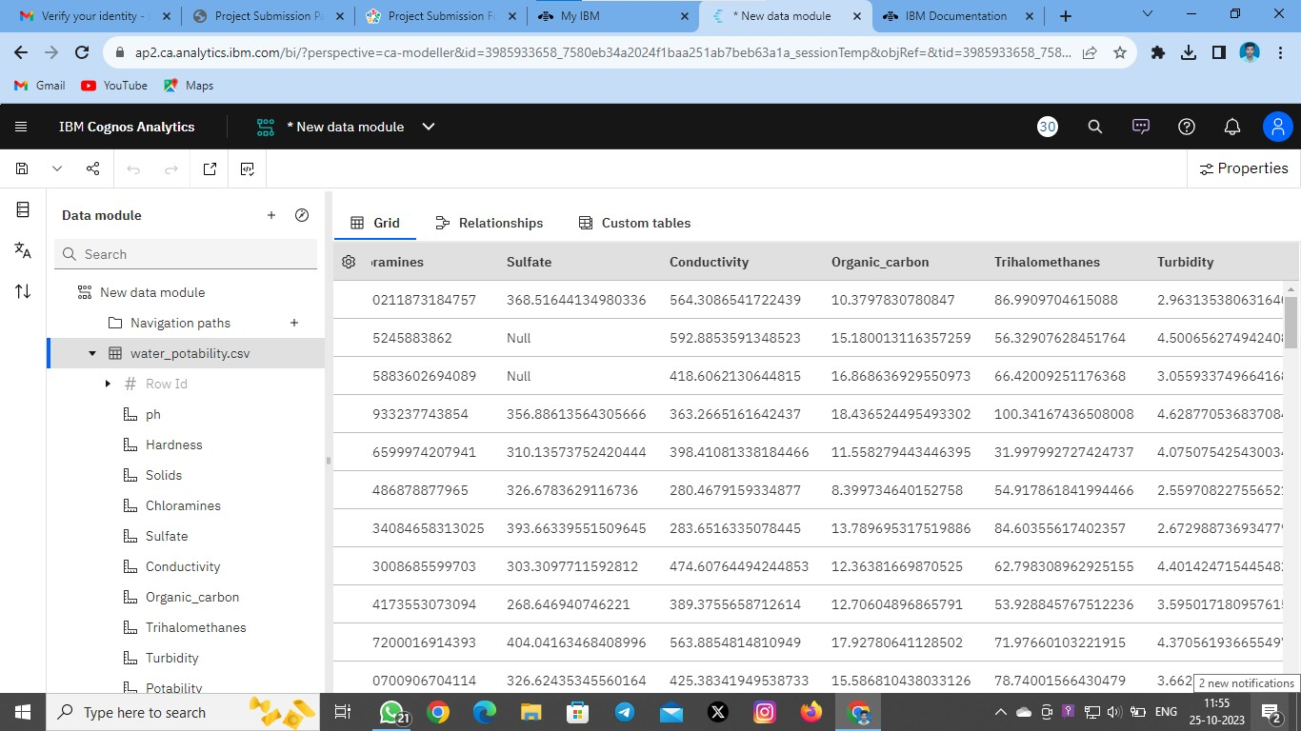

Slide 6
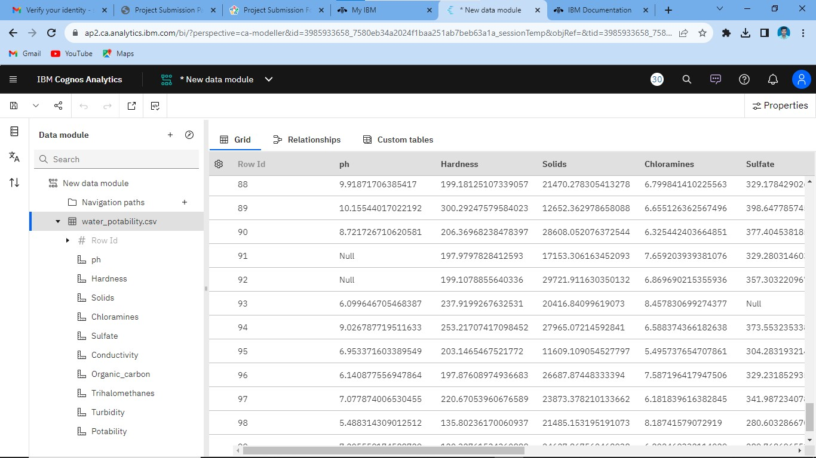

Slide 7
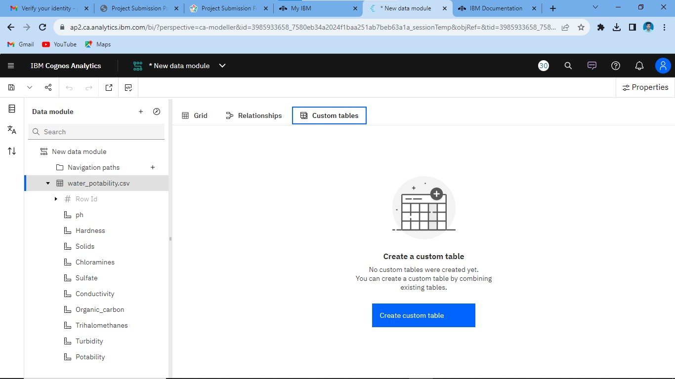

Slide 8
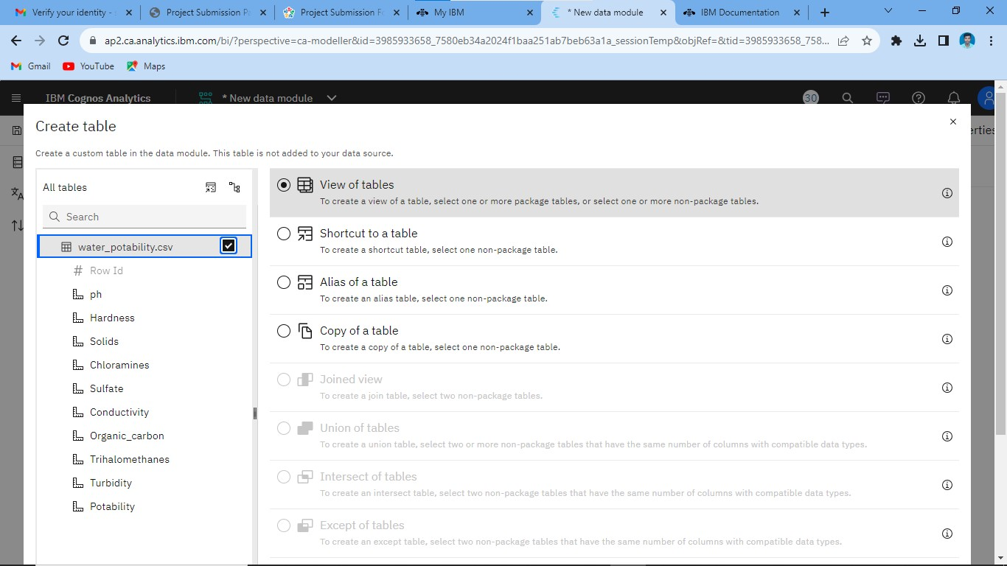
Step-3:Data preprocessing and cleaning

Slide 9
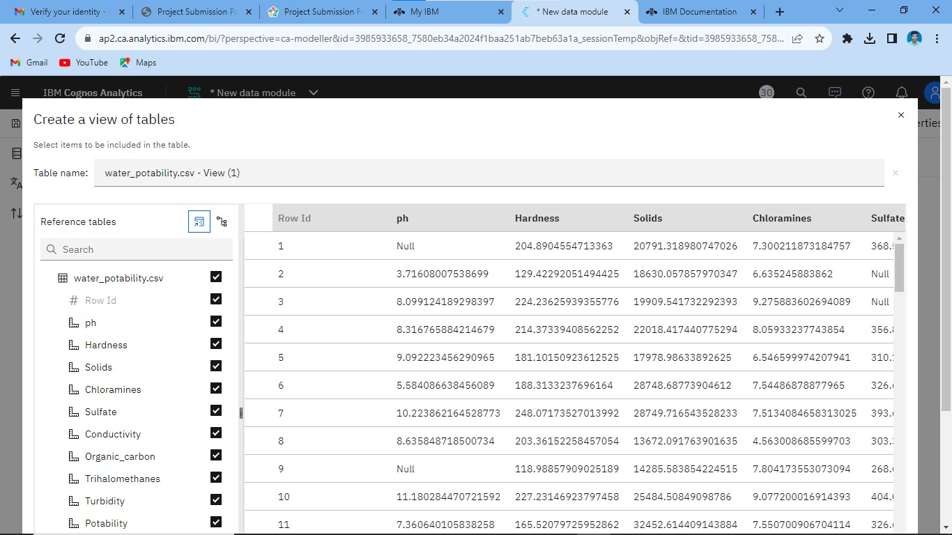

Slide 10
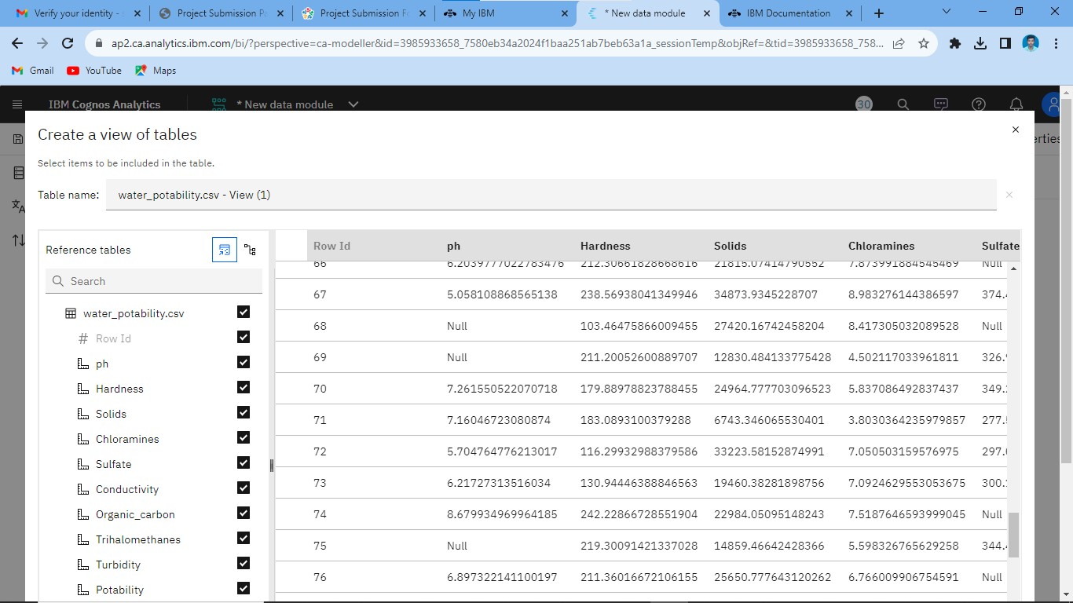

Slide 11


